Slide 1


Predicting Customer Churn in Telecom Industry using Random Forest-A Data Driven Approach
PRESENTED BY :​
GROUP 5
SHIVA SAI SHASHANK MAMIDI​
DEEPAK KUMAR SAMPATH KUMAR​
SRINU PERUMALLA​
YUVA TEJA NAGAPATLA​
SHANTHAN REDDY KATUKURI​
NIKHIL PAMIDI

Slide 2

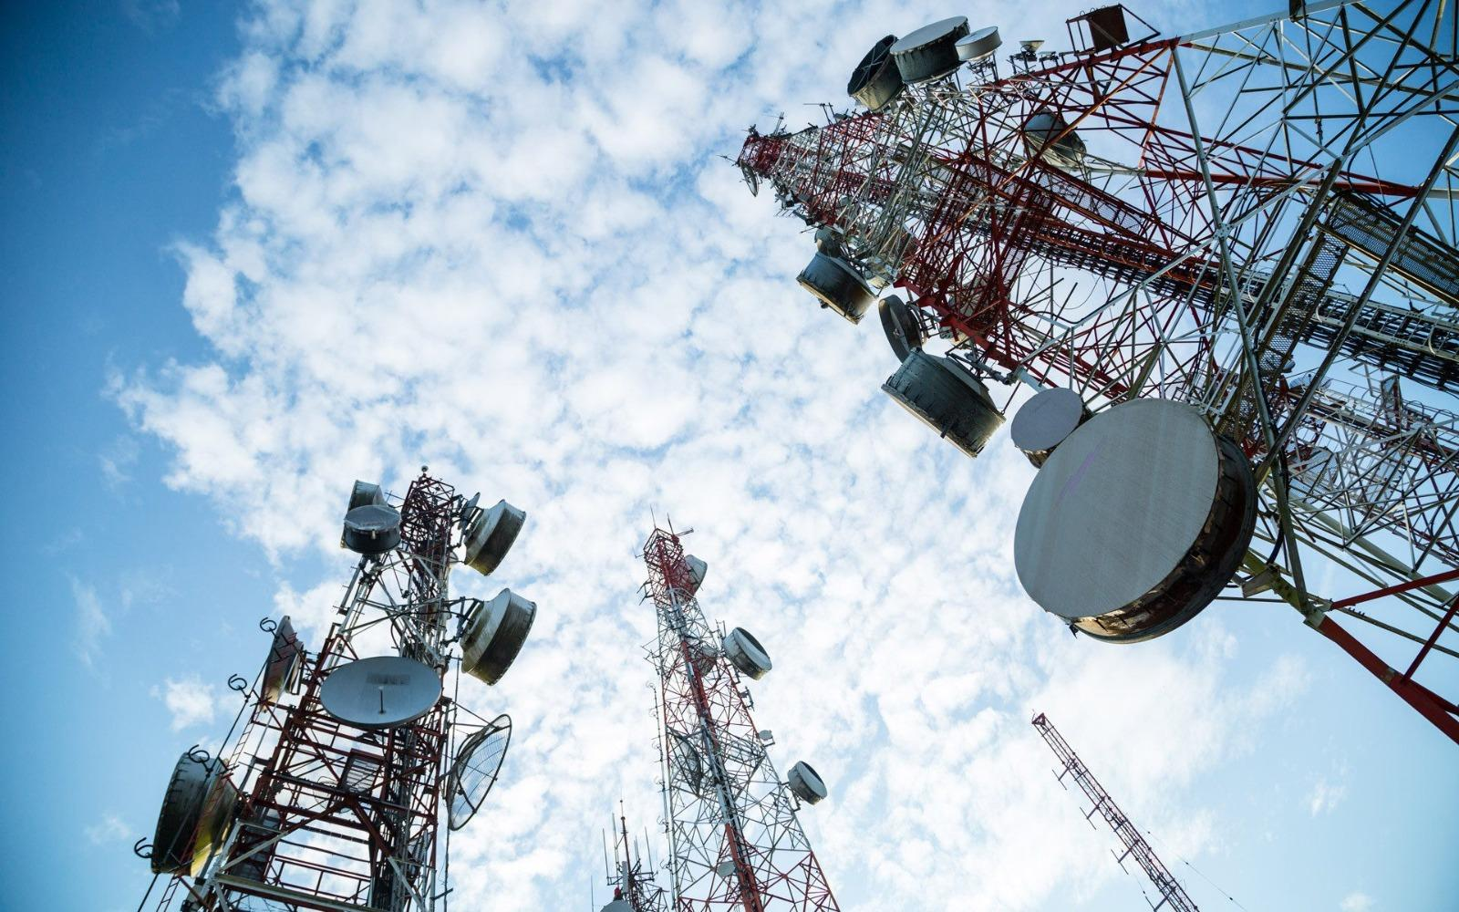
INTRODUCTION :
In today's increasingly competitive telecom sector, customer retention is critical for long-term business growth and profitability. Customer churn, or the phenomena in which users cancel their service with a telecom provider, is a significant concern for enterprises in this sector. Identifying and anticipating churn in advance enables telecom businesses to proactively deploy retention tactics, reducing revenue loss and retaining a loyal client base.

Slide 3

Tools & Technologies used in project:
1
Google Colab - Development environment
2
Python language
3
Pyspark technology

Slide 4

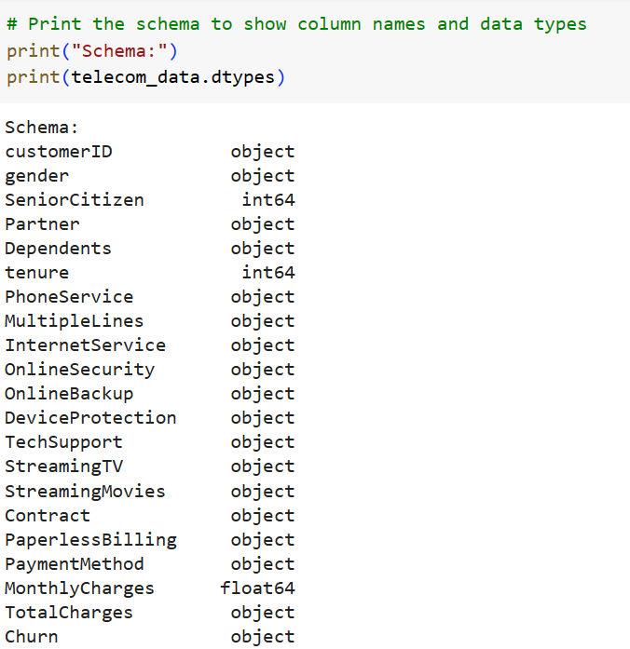
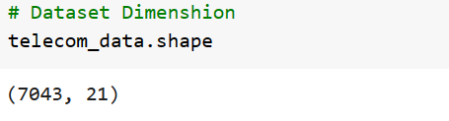
DATA SET :
Quick Review of Data
Sample Size : 7,043 Customer Records
Features : 21
(where 17 are categorical variables and
other 4 are Continuous variables)
Target Variables : Churn (Yes/No)

Slide 5

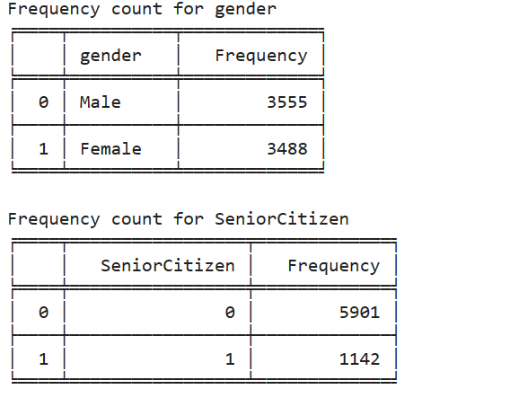
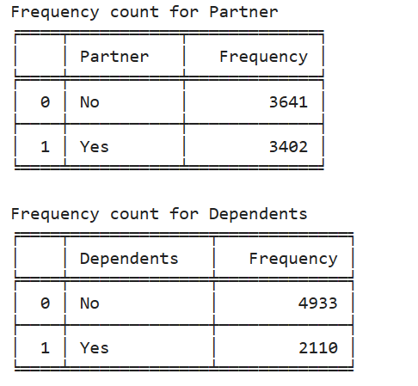
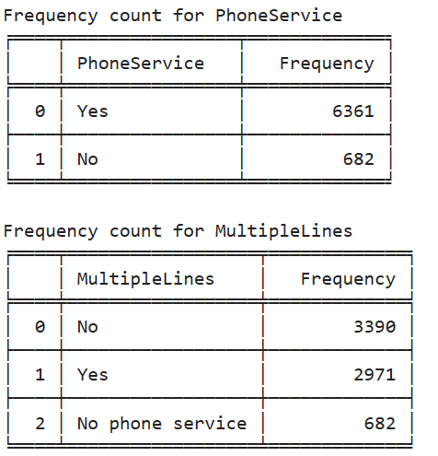
Data Exploration for categorical variables:
Data exploration is the first stage of data analysis, in which you explore into a dataset to comprehend its properties, discover trends, and identify potential insights.
For the better Understanding and Exploring the data we had performed the frequency count on all the categorical variables.
Data Exploration :

Slide 6
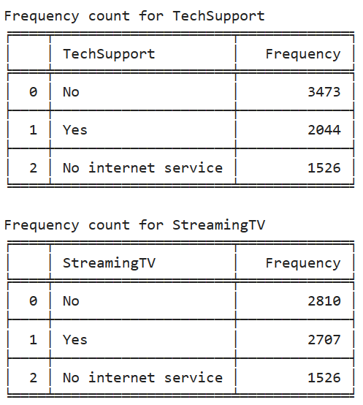
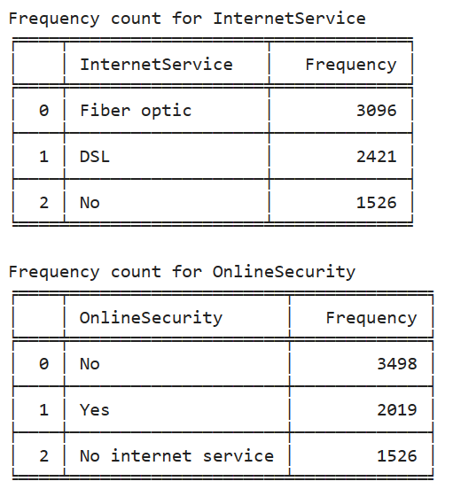
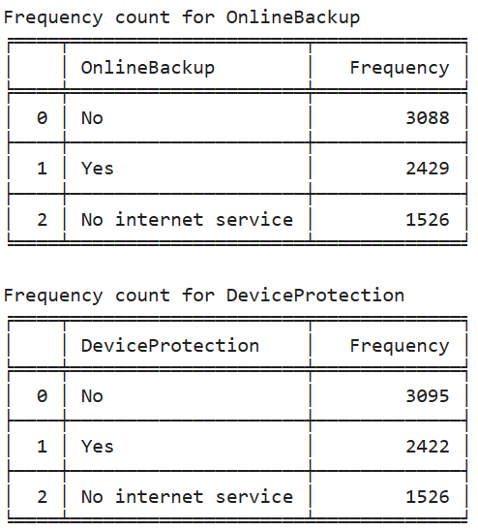
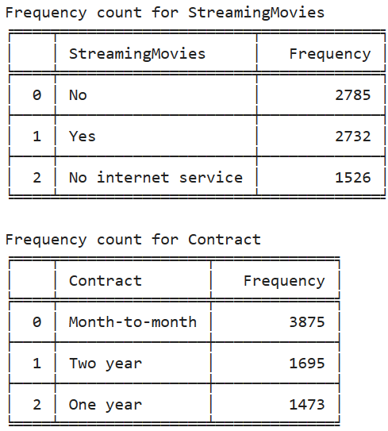
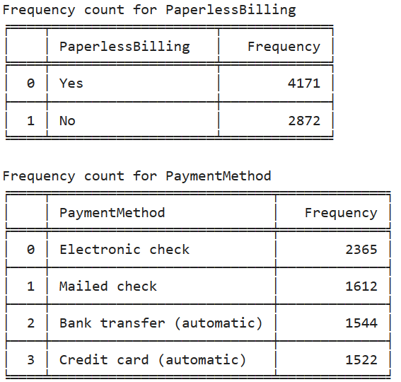
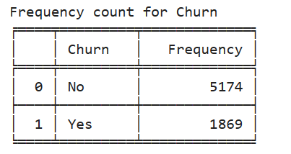

Slide 7

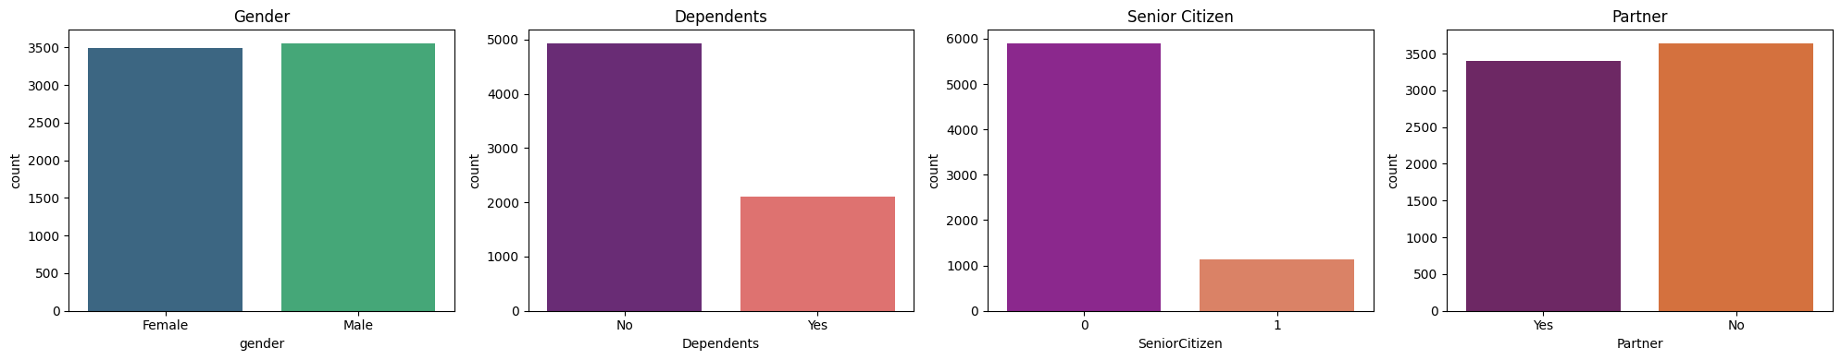
Data visualization for categorical variables:
Male: 50.47%
Female : 49.53%
Dependents : 29.95%
Non-Dependents:
70.05%
Senior citizens:
16.21%
Non-senior citizens:
83.79%
Partner:
48.30%
Individuals:
51.7%

Slide 8
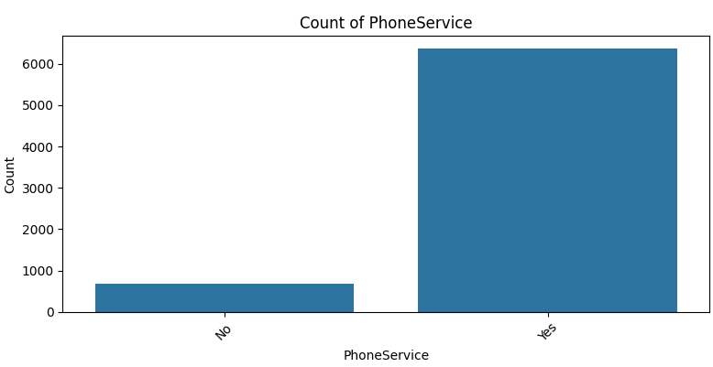
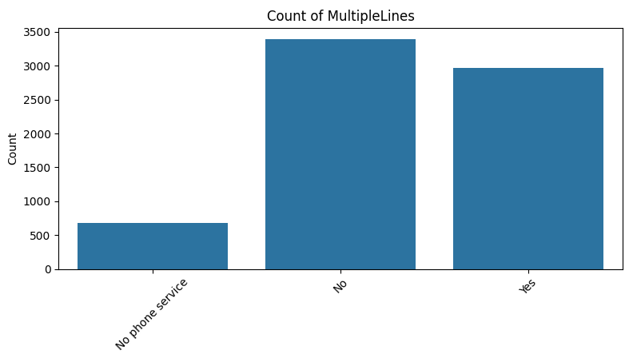
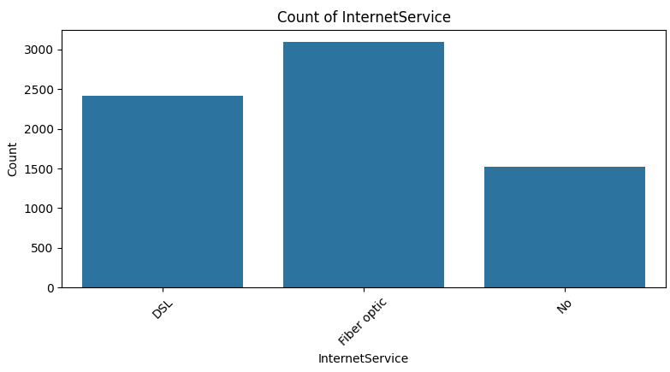
Internet service for dsl : 34.37%
For Fiber optic : 43.95%
For no internet service : 21.66%
Count of Phone Services :
Customers with calls and texts: 85.95%
Customers without phone services: 14.05%
No phone service for multiple lines : 9.68%
Without multiple lines: 48.13%
multiple lines services : 42.18

Slide 9
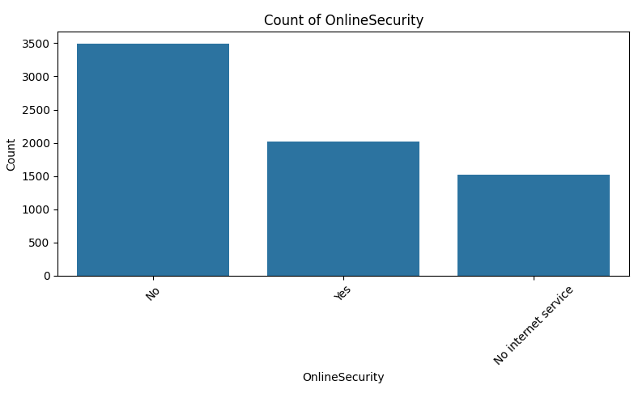
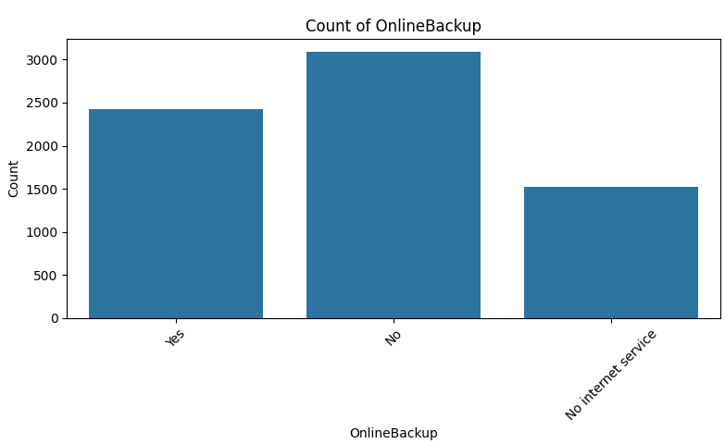
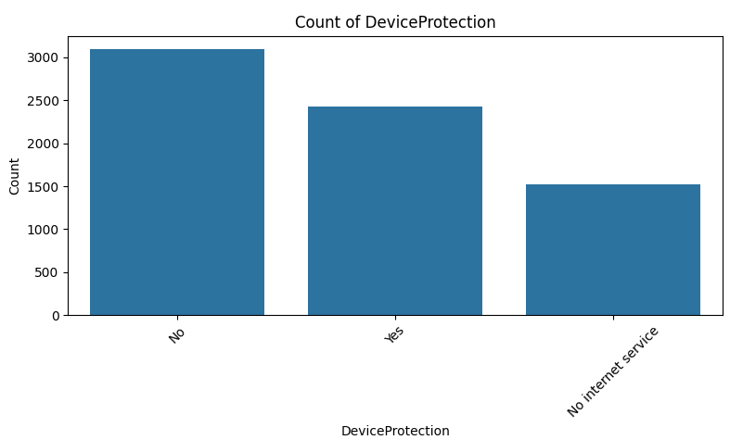
Count of Device Protection
Customers with No device protection:43.94
Customer with Device Protection:34.38
Customer with No internet service:21.66
Count of online security:
Customers with no security: 49.66%
Customers with online security: 28.66%
With No internet service: 21.66%
Count of online Backup
Customers with backup:34.48
Customer with No backup:43.84
Customer with Nointenet service
: 21.66

Slide 10
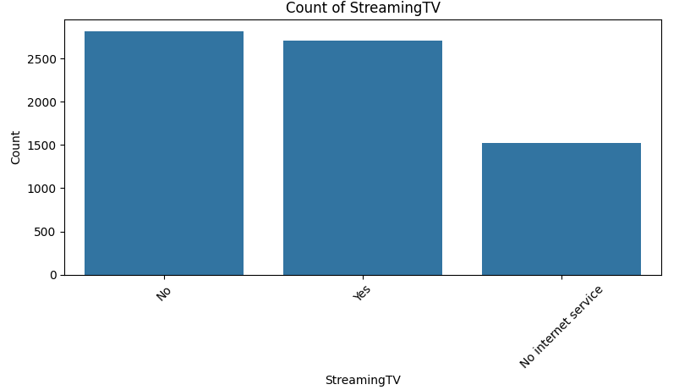
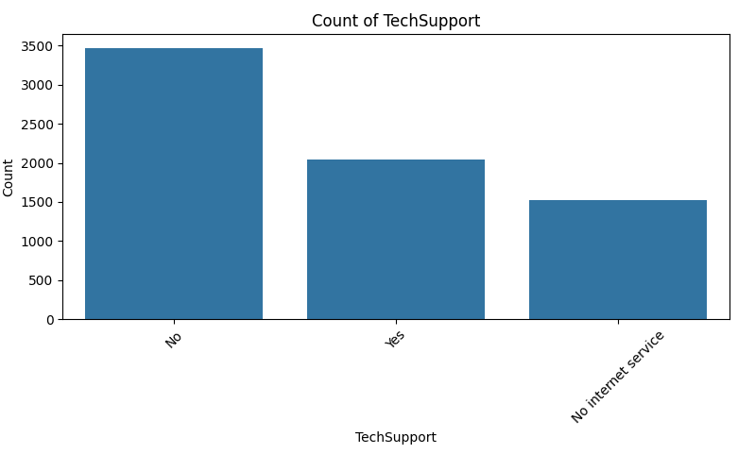
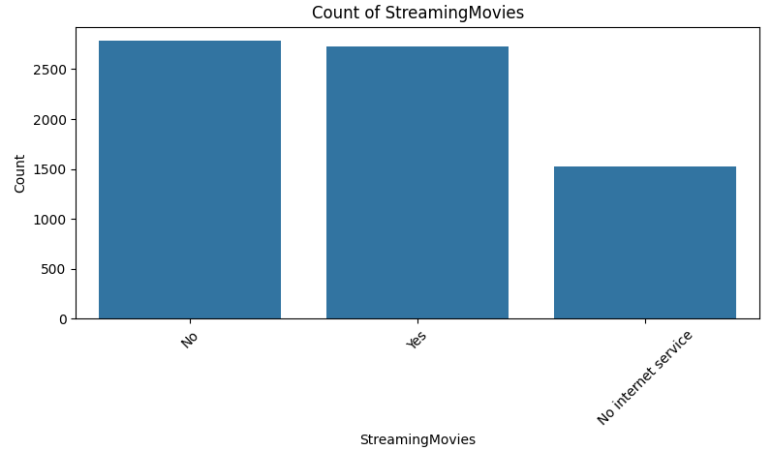
Count of Tech Support :
No Service : 49.31
Services Available : 29.02
No internet service : 21.66
Count of Streaming Movies :
No Customers : 49.54
Active Customers : 48.79
No internet service—21.66
Count of Streaming TV :
Non Active : 39.89
Active Customers : 38.43%
no Streaming TV service : 21.66

Slide 11
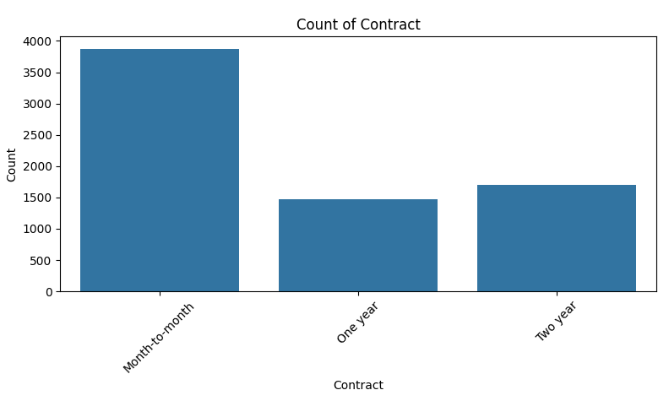
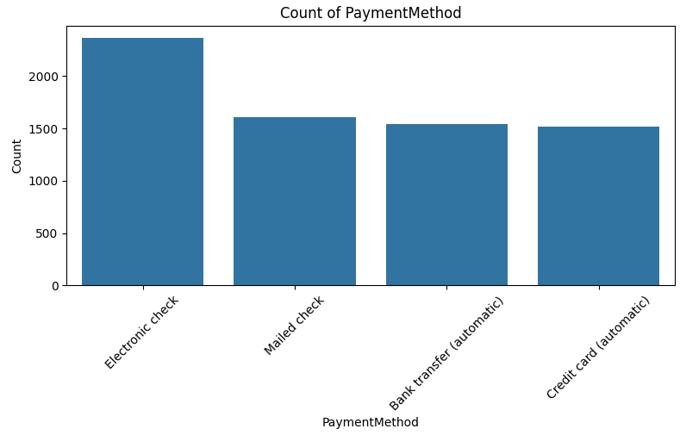
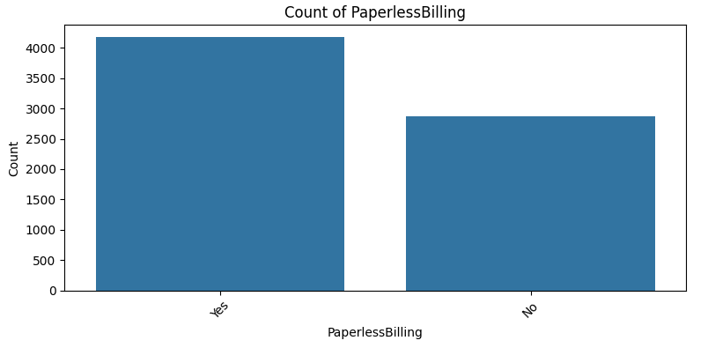
For the paperless billing
For paperless billing : 59.22
For no-paperless billing : 40.77
For the count of customer contract:
For month to month : 55.01
For one year contract: 20.91
For couple of year’s: 24.06
For the count of payment method
Payment done through Electronic check : 33.57
Payment done through Mailed check : 22.88
Payment done through Bank transfer : 21.61
Payment done through Credit card : 21.61

Slide 12
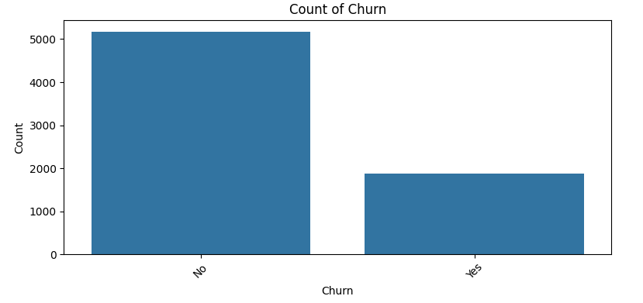
Count of Churn :
Customer stay : 73.46 (NO)
Customers leaving : 26.54 (Yes)

Slide 13
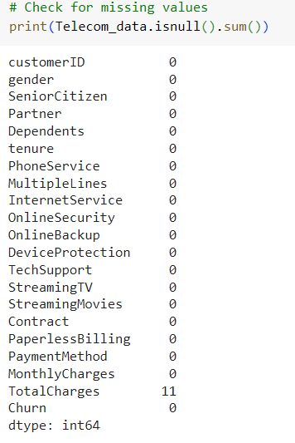
Identify missing values:
We have found that especially for Total charges having 11 missing count values(i.e Blanks).

Slide 14
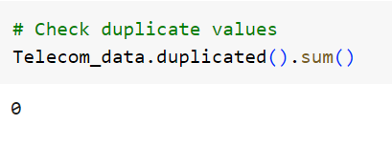
Identify Duplicate values:
In this dataset, we found that there are no such duplicates,which helps the model to train efficiently.

Slide 15
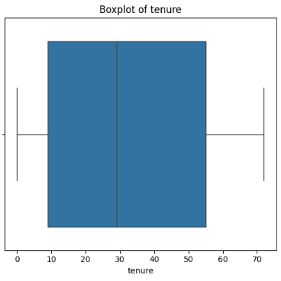
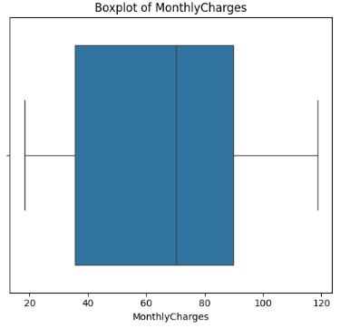
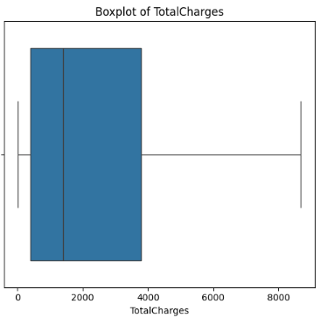
Data Visualization : Outliers [ BOX PLOT ]
A box plot is a visual way to display the distribution of a dataset, showing the median, quartiles, and potential outliers. Outliers are data points that fall significantly outside the typical range of values.
By looking at the box plot of tenure , we can see that there are significant differences in the distribution of monthly charges,total charges for customers.
The median tenure is around 30 months, suggesting half of the customers have a tenure less than a year
The median is around $1800 with the upper quartile stretching quite far, suggest that there are customers who spent a lot over time
The median monthly charge is around $ 70

Slide 16
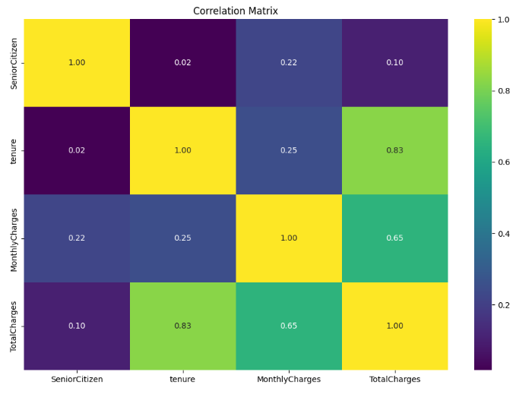
CORRELATION MATRIX
A correlation matrix shows the relationships between the variables in a dataset. It tells us how strongly variables are related to each other.
This is useful in understanding dependencies, identifying patterns, and making predictions in data analysis.
Here in this Heat map ,we observe that a strong correlation (0.83) between Total Charges and tenure, as well as a Moderate correlation (0.65) between Total Charges and Monthly Charges & viceversa.This suggests that as the monthly charges and total charges increase, the customer's tenure with the telecom provider also tends to increase.
Overall, the correlation matrix provides initial insights accurately,which can further guide to feature selection and model development for this project.

Slide 17
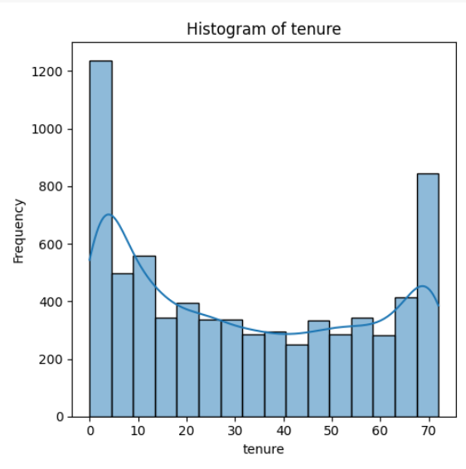
Data Visualization : [Histogram]
Let us know about Tenure ?
Tenure : It refers to the Customer who stayed with the company for a long time.It indicates the customer loyalty and satisfaction of service provided by the service provider.
Initial Tenure: The histogram shows that there were a high number of customers who joined in telecom industry initially (around 1200 customers).
Fluctuations: The number of customers fluctuates over time, with some months having more customers than others.
Decrease over Time: The histogram shows a trend of the number of customers decreasing over time (from a high of 1200 to around 800 customers).

Slide 18
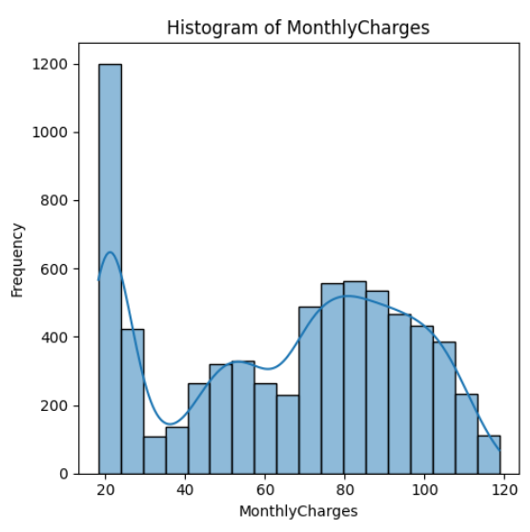
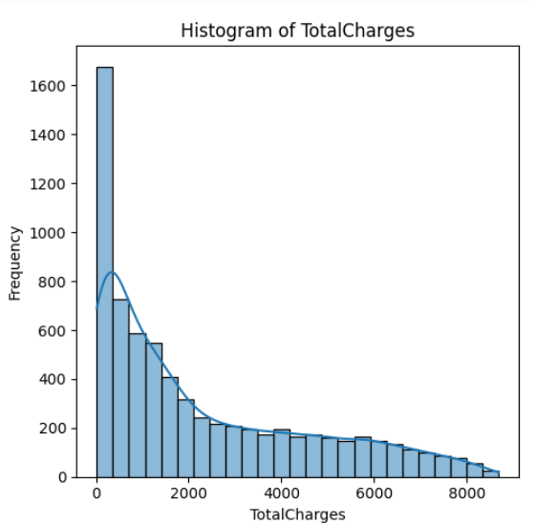
Monthly charges vary significantly,with customers distributed across low to high monthly payment plans
For Total Charges the histogram right-skewed, showing that large number of customers have lower total charges with respect to frequency

Slide 19
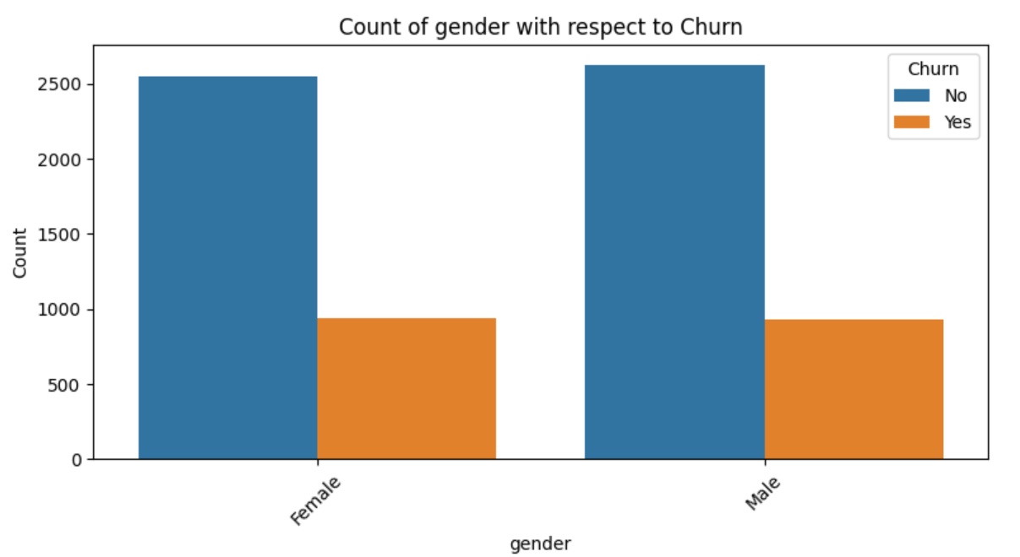
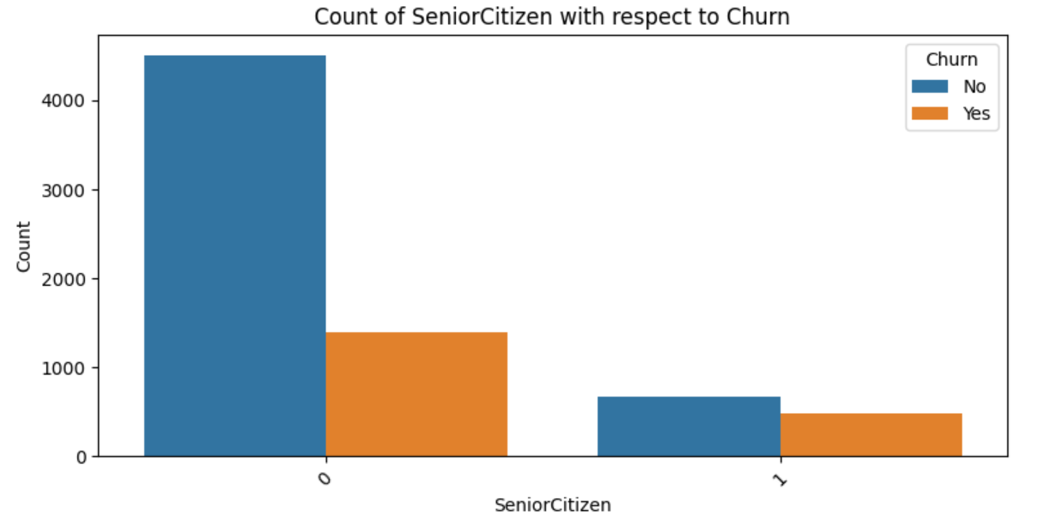
Data Analysis :
Churn : It refers to the rate at which customers stop using a service or switch from one service provider to another.
Here 0 represents non-senior citizens
In total there are 5901 Non senior citizens & in that 1393 people are churned
And 1 Represents senior citizens
In total there 1142 senior citizens in that 476 people churned
As per the data, there are 3555 males, out of which 930 males had churned
Similarly, total count of females 3488, out of which 939 are Churned

Slide 20
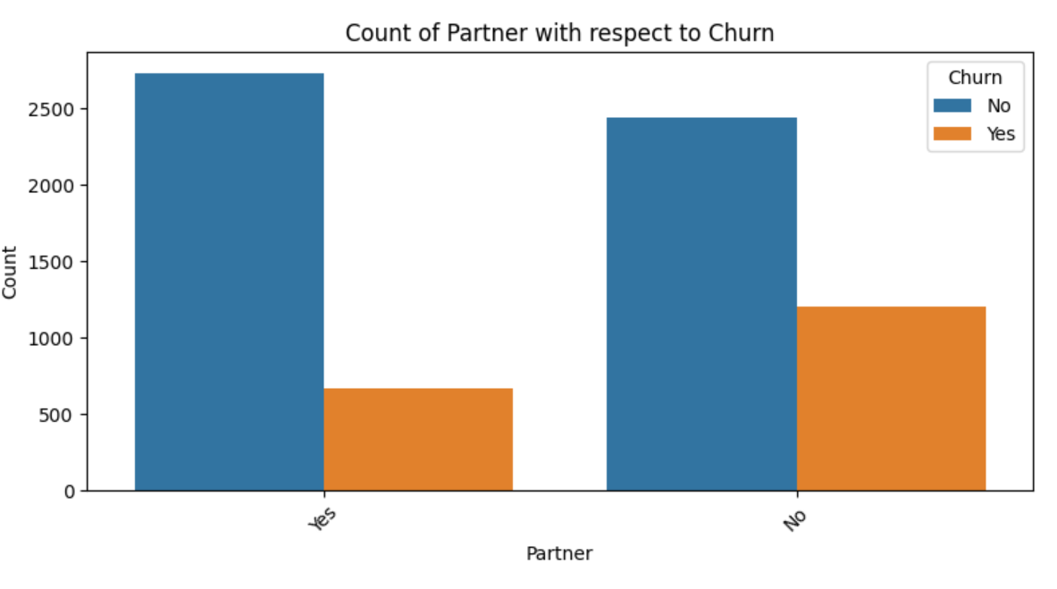
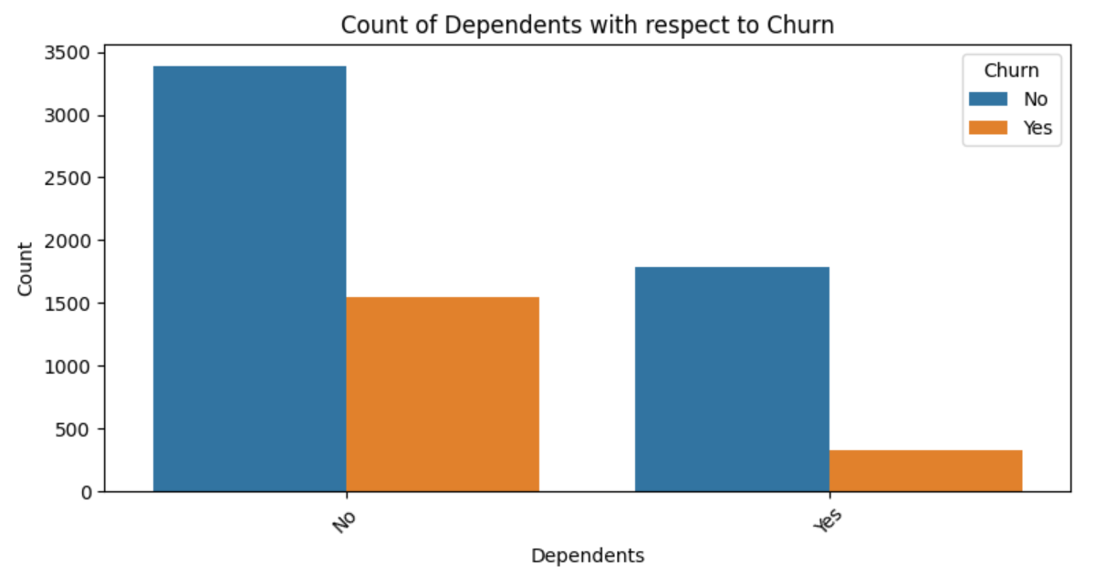
Count of total partner are 3402 In that Count of active partners 2733 and 669 are churned
Count of total non-partner are 3641
Count of active-non partners are 2441 and 1200 are churned
Here Total Count of Non-Dependents are 4933. in that are 3390 active Non-Dependents . Out of that 1543 are churned.
Here Total Count of Dependents are 2110, in that 1784 are active Dependents . Out of that 326 are churned.

Slide 21
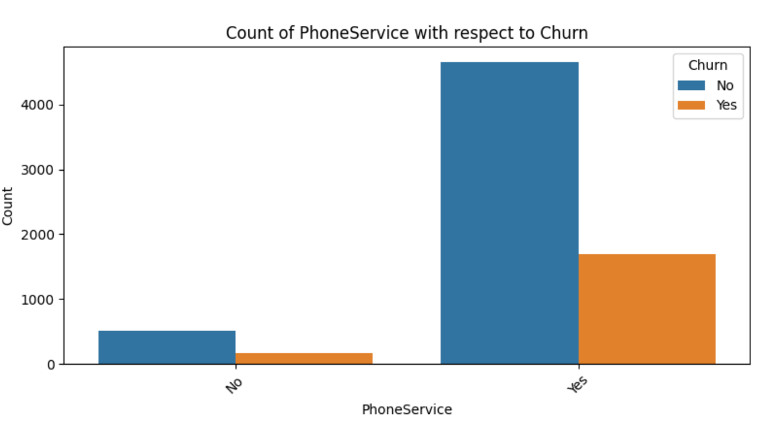
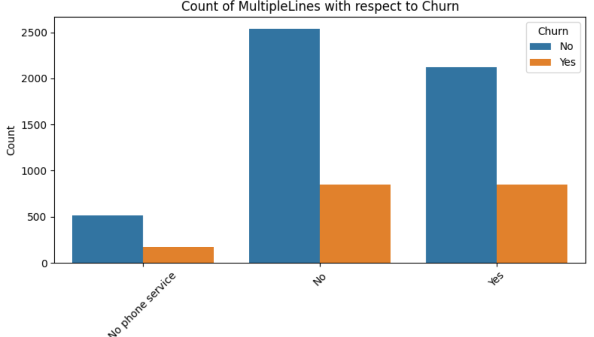
For Non Phone services,total Count is 682 In that Count of active Non Phone services 512 and 170 are churned
For Phone services total Count is 6361
In that Count of active Phone services are 4662 and 1699 are churned
For no phone services ,its total count is 682
In that 512 active and 170 are churned
For singleline(i.e No) services ,total count is 3390
In that 2541 singleline are active and out of that 849 are churned
For multiple line services (i.e Yes),2791 is the total count
In that Active multiple lines are 1941 and 850 are churned

Slide 22
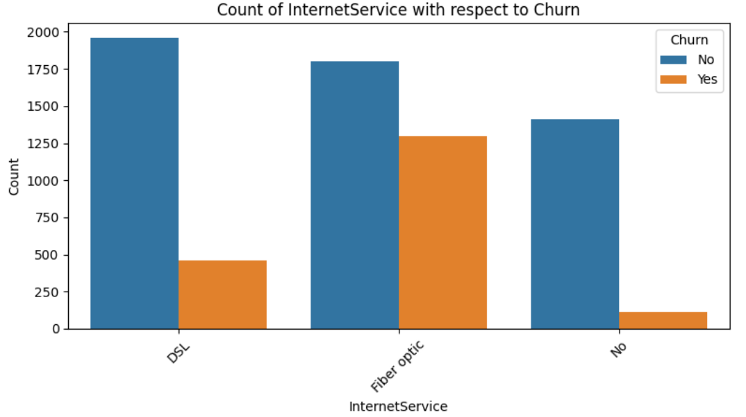
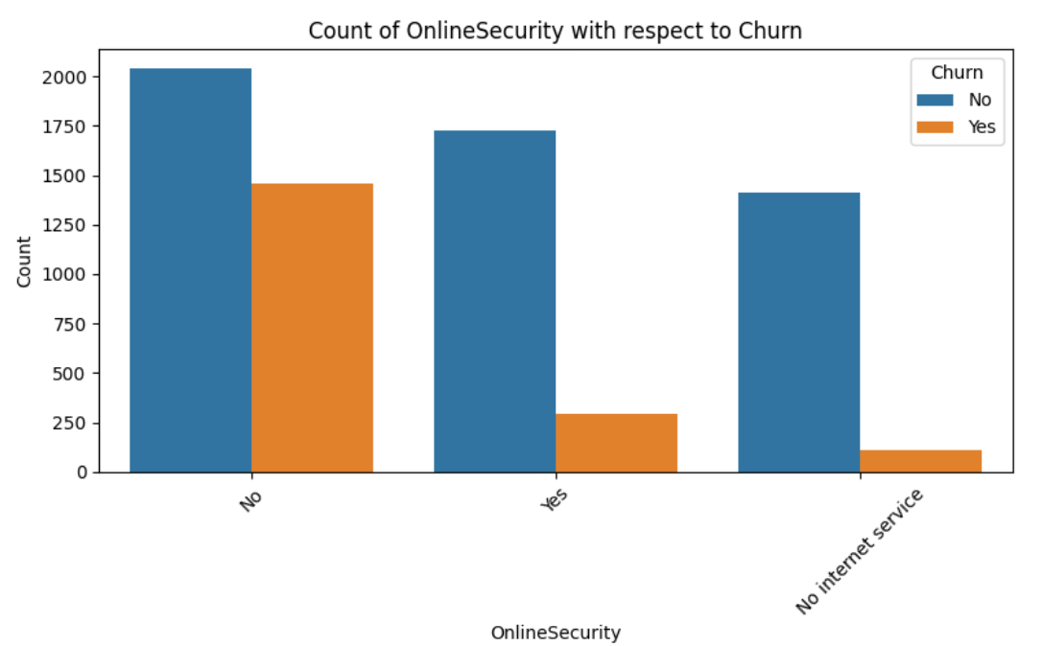
In this, DSL Total Count is 2421,ACTIVE 1962,out of this 459 are Churned
For Fiber optic,Tc 3096 active 1799 and 1297 are churned
For No internet serviceTc 1526 active 1413 &113 are churned
In this,NO online security total count 3498 Active 2037 and 1461 are churned
For Yes totalcount is 2019,1724 are active and 295 are churned
For No internet service total count is 1526 and active 1413 and 113 are churned

Slide 23
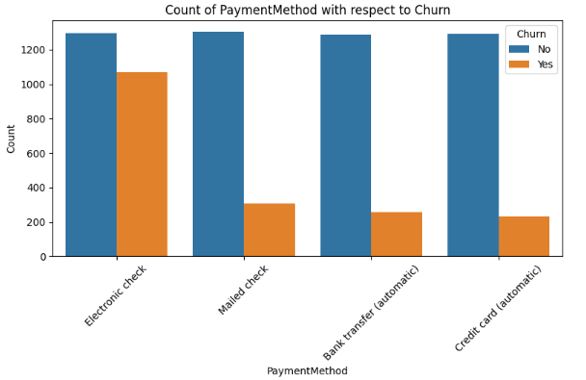
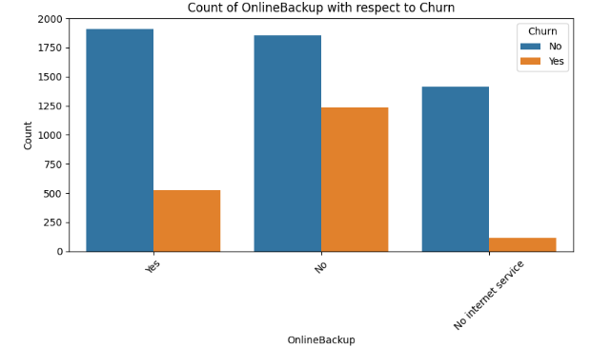
In payment method ,electronic check 2365 total count ,active 1294 and 1071 are churned
For mailed check total count 1612, active is 1304 and 308 are churned
And for bank transfer total count 1544 ,in that active 1286 and 258 are churned
Lastly for credit card total count 1522 ,in that active is 1290 and 232 are churned
For having online backup total count 2429, active is 1906 and 523 are churned
For not having online backup (NO )total count 3088, active is 1855 and 1233 are churned
For no internet service total count 1526, active is 1413 and 113 are churned

Slide 24
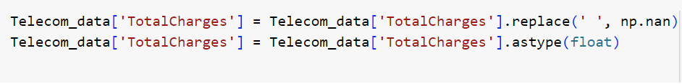
Data Preprocessing : Converting Total charges to float:
'Total Charges' column converting object data type to float data type using the .astype() method. By specifying float, it explicitly converts the values to floating-point numbers
Empty strings or whitespace in 'Total Charges' column with NaN using the .replace() method. This step is necessary to handle non-numeric values gracefully, ensuring they don't interfere with the conversion process.
It is required to ensuring that it contains only numerical values and converting it to float data type for further analysis or computations.

Slide 25
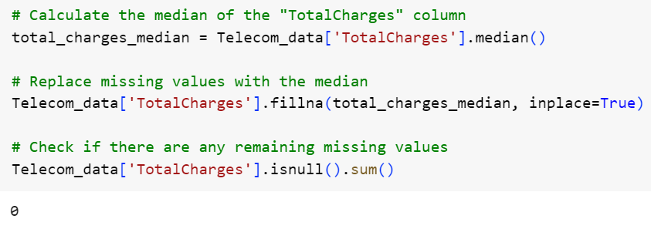
Data Preprocessing :
Replace missing values in Total charges with median
Because there are 11 blank spaces in total charges column, So we used the median method to fill na values with using fillna method
and we cross checking the missing values.

Slide 26
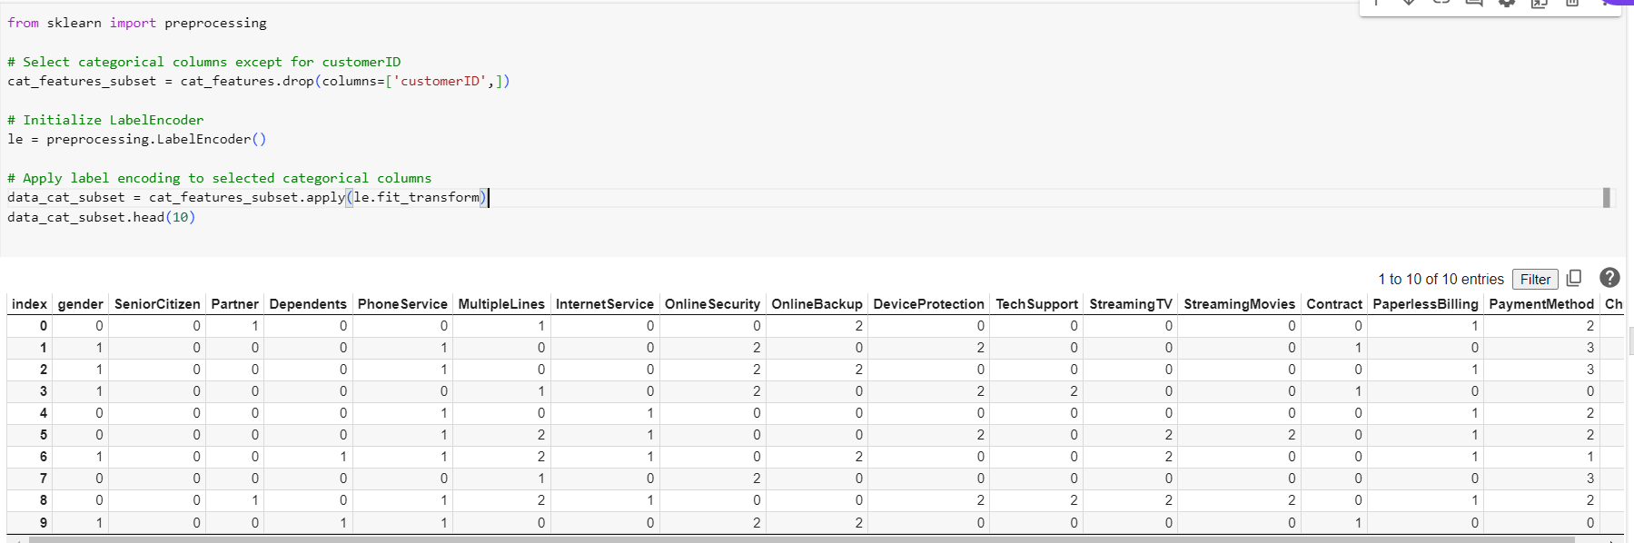
Label Encoding Categorical Features
We have categorical variables and these are changed to numerical variables to featuring
Initializes a LabelEncoder and applies it to encode categorical values into numerical labels.

Slide 27
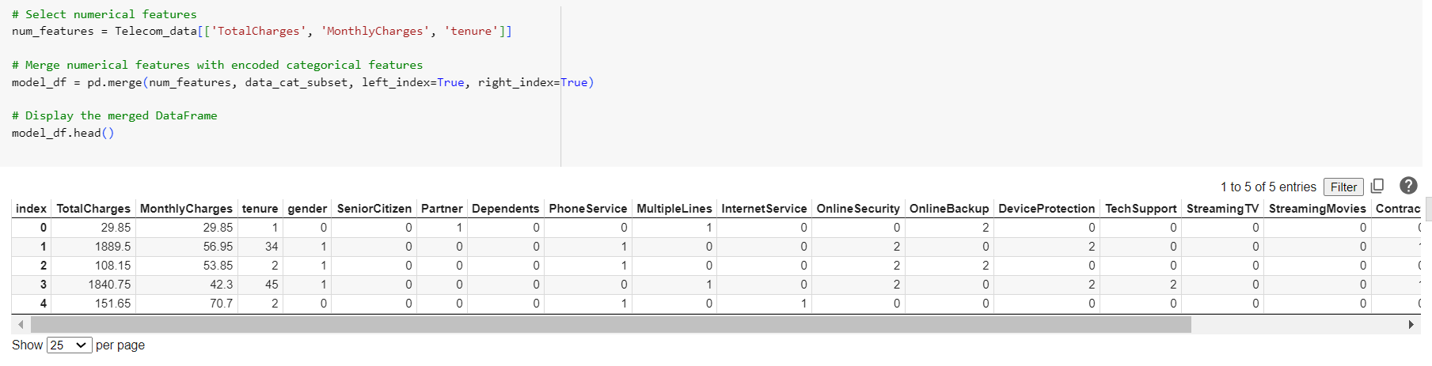
Merging Numerical and Encoded Categorical Features
After performing the label encoding feature now we merge the numerical and categorical features and display their respect output as shown in the slide

Slide 28
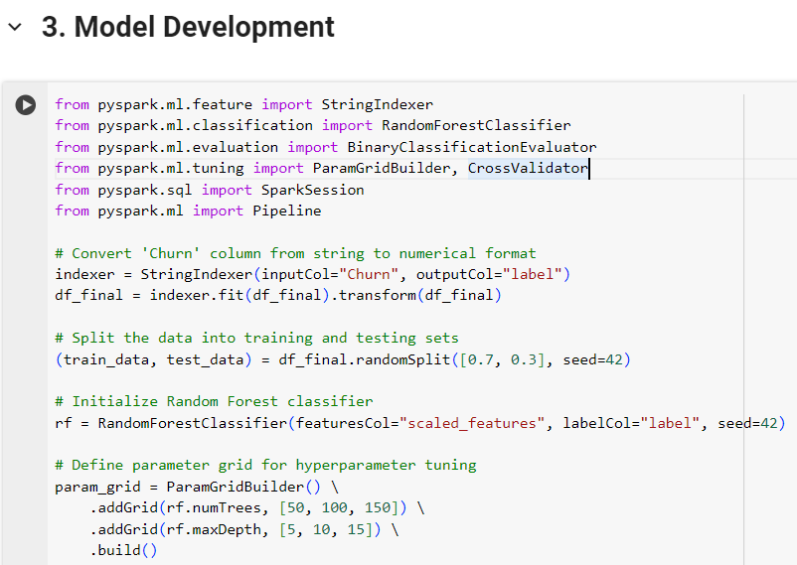

Slide 29


Slide 30


Slide 31

From this, we suggest it has a satisfactory discriminatory power in distinguishing between the classes in the evaluation set.

Slide 32


Slide 33

True Positive (TP): There are 1410 instances that are correctly predicted as positive (actual positive and predicted positive).
True Negative (TN): There are 182 instances that are correctly predicted as negative (actual negative and predicted negative).
False Positive (FP): There are 109 instances that are incorrectly predicted as positive (actual negative but predicted positive).
False Negative (FN): There are 306 instances that are incorrectly predicted as negative (actual positive but predicted negative).
By evaluating the model's accuracy, precision, recall, F1-score, and ROC-AUC score, as well as visualizing the ROC curve, we gain a comprehensive understanding of the model's performance and identify its strengths and weaknesses. This information can be used to further optimize the model or make informed decisions about its deployment.

Slide 34
Deployment and interpretability :
Deployment :
The code snippet below is about flask web application. A well-liked Python framework for creating web apps.The code loads a scaler (scaler.joblib) and a pre-trained machine learning model (random_forest_model.joblib) from files. These files most likely contain the scaler and model's serialized versions, which are prepared for deployment.
Interpretability :
The machine learning model cannot be directly interpreted by this code snippet alone. Its inner workings can be somewhat understood, though, because it employs a Random Forest model. It is possible to compute feature importance scores to determine which features most significantly affect the model's predictions.On the other hand, compared to more straightforward models like decision trees, Random Forest models are typically thought to be less interpretable.

Slide 35


Slide 36
Business insights :
Customer churn risk assessment: By examining their data points, the program can assist the company in identifying clients who are at a high risk of leaving. This makes it possible to implement focused interventions to keep important clients.
Better customer experience: Companies can enhance their services or offerings to alleviate pain points and reduce turnover by identifying the variables that lead to customer churn.
Data-driven decision making: Marketing campaigns, resource allocation, and client retention strategies can all be informed by the model's predictions.
Segmenting customers:
High- and low-risk categories: Create client segments based on high- and low-risk attributes by analyzing customer demographics, behavior patterns, and projected churn probabilities. This makes tailored retention tactics possible.
Reasons for segment churn: Recognize the main causes of attrition in each section. This could highlight problems with a product for one market or worries about pricing for another, requiring customized fixes.

Slide 37
Recommendations:
Enhancing the model : It could involve adding more consumer data points, which could increase the accuracy of the model.To keep the model working well, retrain it on new data on a regular basis.
Practical insights: Convert model forecasts into useful information that customer support or retention teams can use.Create specialized advertising based on anticipated attrition.
Interpretability: Investigate methods such as LIME (Local Interpretable Model-agnostic Explanations) to acquire more profound understanding of the model's decision-making process for particular consumers, even though feature importance can offer some comprehension. This may aid in improving targeted tactics.
Deployment factors to consider:
To guarantee scalability and reliability in a production setting, investigate containerization and orchestration platforms such as Docker and Kubernetes.
Establish recording and monitoring systems to keep tabs on model performance and spot possible problems.

Slide 38
Conclusion:
In conclusion, the Random Forest model developed in this project demonstrates promising performance in predicting customer churn in the telecom industry. By leveraging advanced analytics and machine learning techniques, telecom companies can proactively address customer churn and enhance customer retention, thereby enhancing business sustainability and profitability.

Slide 39

THANK YOU !!
ANY QUERIES ??

